Slide 1

BS1220: Introduction to Software Design and Development
Week 8 Hybrid Session 2

Slide 2
8.8: Completing a Competitor Analysis
Develop a table which contains at least:
Name of competition
Features
Positive aspects
Negative aspects
Competitor Application | Features | Target Users | Positive Aspects | Negative Aspects | Cost | Promotional Activities | User Feedback | What can we learn from this application?

Slide 3

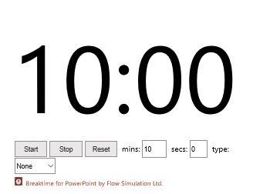
Activity 3
Complete a Competitor Analysis for the case study you developed in the post-session activities last week

Slide 4

8.9: Debate
Competitor and Feasibility Analysis is a Waste of Time and Resources

Slide 5

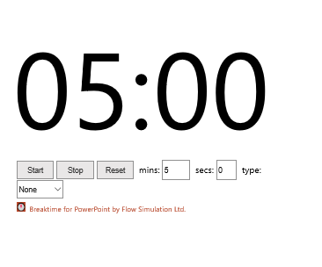
Final Preparation Time

Slide 6
Rules Reminder
This will be a civilised debate
No interrupting people who are speaking – keep your microphones muted
If you want to say something, raise your virtual hand
No personal attacks – we will only be discussing the topic at hand
Stick to your allocated time – the debate chair will let you know when you are finished, there will also be a timer on the screen to help you
The decisions of the debate chair are final.

Slide 7
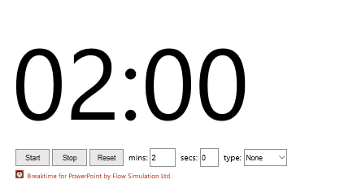
Initial Statement - FOR
This will be a civilised debate
No interrupting people who are speaking – keep your microphones muted
If you want to say something, raise your virtual hand
No personal attacks – we will only be discussing the topic at hand
Stick to your allocated time – the debate chair will let you know when you are finished, there will also be a timer on the screen to help you
The decisions of the debate chair are final.

Slide 8
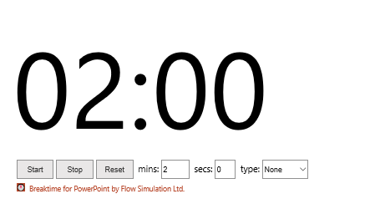
Initial Statement - AGAINST
This will be a civilised debate
No interrupting people who are speaking – keep your microphones muted
If you want to say something, raise your virtual hand
No personal attacks – we will only be discussing the topic at hand
Stick to your allocated time – the debate chair will let you know when you are finished, there will also be a timer on the screen to help you
The decisions of the debate chair are final.

Slide 9
Rebuttals and Open Discussion
This will be a civilised debate
No interrupting people who are speaking – keep your microphones muted
If you want to say something, raise your virtual hand
No personal attacks – we will only be discussing the topic at hand
Stick to your allocated time – the debate chair will let you know when you are finished, there will also be a timer on the screen to help you
The decisions of the debate chair are final.

Slide 10
Closing Statement - FOR
This will be a civilised debate
No interrupting people who are speaking – keep your microphones muted
If you want to say something, raise your virtual hand
No personal attacks – we will only be discussing the topic at hand
Stick to your allocated time – the debate chair will let you know when you are finished, there will also be a timer on the screen to help you
The decisions of the debate chair are final.

Slide 11
Closing Statement - AGAINST
This will be a civilised debate
No interrupting people who are speaking – keep your microphones muted
If you want to say something, raise your virtual hand
No personal attacks – we will only be discussing the topic at hand
Stick to your allocated time – the debate chair will let you know when you are finished, there will also be a timer on the screen to help you
The decisions of the debate chair are final.

Slide 12


Debrief - Reflection
How did this help (or hinder) your thinking about the advantages and disadvantages of competitor and feasibility analysis?
What is your overall opinion now? (Regardless of which side you were arguing)
Has your opinion changed?
What did you find hard about this process?
What did you find easy about this process?

Slide 13
8.10: Overview
To understand the definition and purpose of feasibility analysis
To explore the definition and purpose of competitor analysis
To evaluate the benefits and drawbacks of conducting a feasibility analysis
To assess the benefits and drawbacks of conducting a competitor analysis
To carry out a feasibility study
To understand Porter’s Five Forces Analysis
To perform a competitor analysis
To debate whether feasibility and competitor analysis are a worthwhile exercise

Slide 14
Next Week: Software Development Methodologies
Pre-Session
Defining a Methodology
Types of Methodology
Hybrid Session 1
Software Development Methodologies
Comparing and Contrasting Methodologies
Hybrid Session 2
Choosing Appropriate Methodologies
Project Planning Using Software Development Methodologies

